Slide 1
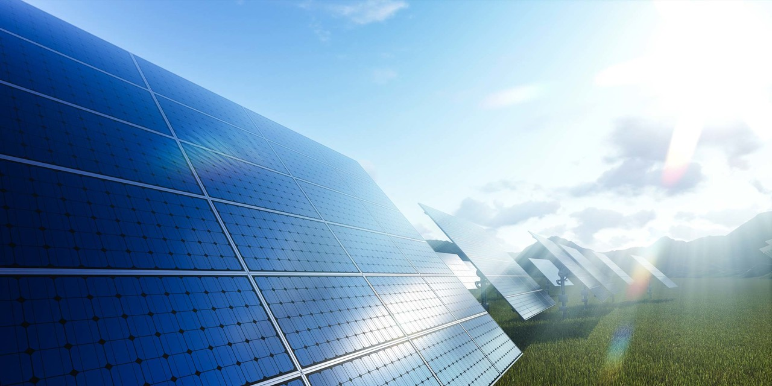

INTALLATION MANUAL
SOLAR PV MODULES
Abundance Solar Panels Industries – LLC
Abu Dhabi, United Arab Emirates
www. abundance-solar.com

Slide 2
1. Company Profile
Abundance Solar Panels Industries LLC is a pioneering solar panel manufacturing company based in the Khalifa Economic Zones Abu Dhabi (KEZAD), UAE. Established with a vision to contribute to the global shift towards renewable energy, Abundance Solar Panels Industries is committed to producing high-quality solar panels using state-of-the-art European technology.
2. Solar Modules
Solar modules supplied by Abundance Solar Panels Industries LLC are series connected crystal silicon solar cells, being permanently encapsulated between Glass/Glass and Back sheet by hot melt adhesive, and installed, this structure can ensure that the solar cells can safely and normally operate in most harsh environment.
Solar panels supplied by Abundance Solar Panels Industries LLC are marketed under the brand name of “ABUNDANCE”
3. Application
Solar PV module supplied by Abundance is charged by DC power supply with high reliability, almost maintenance free, once exposed to sunlight. The modules can be ideally applied in remote areas power system, home power system, renewable energy, hydropower station, automobile water pump, communication system or directly compose solar PV plant, these systems can be both with storage battery, or directly grid-connected without storage battery.

Slide 3
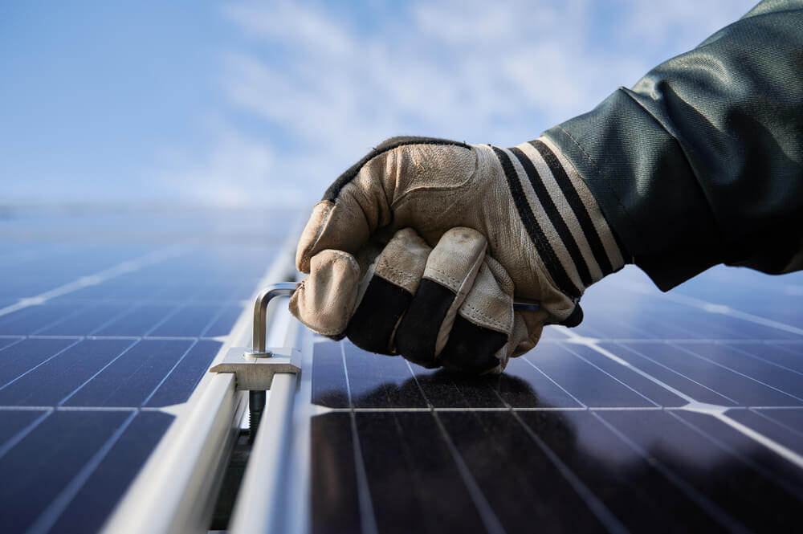
4.Installation Permits
Prior to installation of any solar PV power generation system, please contact the local relevant authorities to determine the installation methods is in compliance with the requirements of the local installation permits and installation inspection requirements.
5.Responsibility Declaration
(1) Due to installations being carried out by the 3rd party, the solar PV generation system, operation and application are beyond company control. Abundance shall not accept any responsibility for any and all direct or indirect losses, expenses or damages caused by incorrect installation, operation, application and/or maintenance, solar modules damages, people casualties or any other additional expenses occurred.
(2) Due to installations being carried out by the 3rd party, the solar PV generation system, Abundance shall not accept any responsibility for any and all patent infringement of third-party rights or any other rights being compromised or violated from the application of solar modules, and/or any direct or indirect losses occurred in connection with such infringement or violation.
(3) Abundance retains the rights to update the products, product specifications and installation manual specification or document rights, without prior notice.

Slide 4

6.Safety Precautions
1. The installation of solar modules must be carried out and completed by certified and qualified professionals.
2. Before installation, wiring, operation or maintenance, the respective installer must:
a) Familiarise itself and have a comprehensive understanding of solar modules, system’s installation, operation or maintenance requirements;
b) Use proper insulated tools and appropriate protective equipment to reduce the risk of electric shocks;
c) Do not stand or step on the module;
d) Do not damage the back or front of the solar module;
e) Do not use solar module with broken front glass or back glass as broken modules cannot be repaired. Any contact with the broken module, surface can lead to electrical shock;
f) Do not disassemble the module or remove any part of the module;
g) Do not use unsafe solar modules
h) Don't make any connection terminal plug dirty and prevent connector contamination;
i) Install fire protection layer on the roof for solar module which is installed on the roof
j) Do not handle or install modules when they are wet or during periods of high wind

Slide 5
7. Climate Condition
Install Abundance Solar Panels Industries LLC solar modules in the following conditions:
Environmental Condition-Operating Temperature:-40°C to +85°,Humidity-Below 85RH%,Mechanical Load Pressure-Below 5400Pa
Environmental condition for solar module working
Note: Mechanical load bearing of each module is based on mounting methods. Professional solar system installers must be responsible for calculating mechanical loads when designing the system
8. Site Selection
1. In most applications, Abundance Solar Panels Industries LLC PV modules should be installed in a location where they will receive maximum sunlight throughout the year. If in the northern hemisphere, solar modules are usually being installed south facing; If in the southern hemisphere, solar modules are usually being installed north facing;
2. Modules should not be covered by shade at any time of the day caused by buildings, trees, chimneys or any similar obstacles. It has to be considered that shade can have seasonal differences, with higher impact especially in winter when the sun is in the lowest horizontal position. Shadow will cause loss of power output of any solar system. The element of shade must not be ignored, although by-pass diodes can reduce losses to a certain extend;
3. Do not install PV modules near fire or flammable & explosive goods, etc.;
4. Do not install PV modules in locations where it would be immersed in water or continually exposed to water, i.e. from a sprinkler or fountain, etc.;
5. Do not install PV modules in corrosive salt areas within close proximity of the ocean; and
6. Do not install PV modules in environment subject to corrosion, such as costal areas, or sulphureous areas, etc.

Slide 6
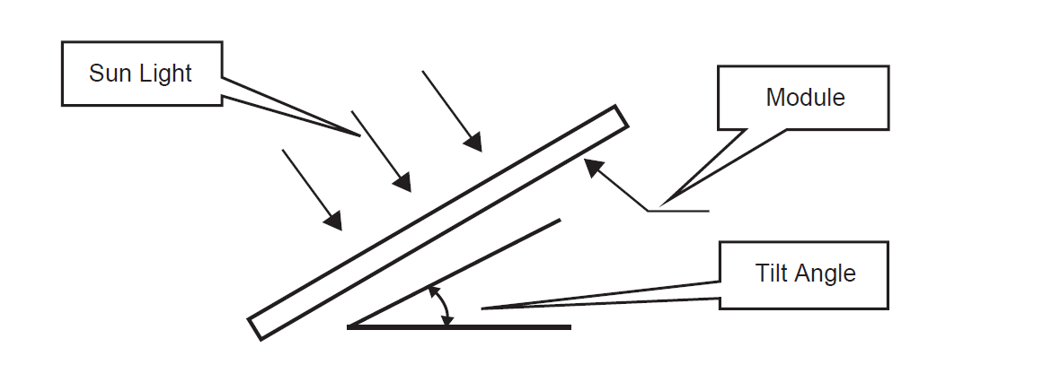
9. Module Tilt Angle
1. Abundance Solar Panels Industries LLC modules connected in series should be installed at the same orientation and angle. Differing orientations or angles may cause a loss of power output due to mismatch of current and voltage caused by the differences of light absorption. This may reduce system efficiency.
2. For the determination of the optimal installation angle of a permanently installed system winter irradiation conditions should be considered. If an ideal installation angle under winter irradiation conditions is being used, other seasonal irradiation conditions will benefit the system's performance.
ABUNDANCE suggests that tilt angle of module installation more than than 10˚
Tilt angle refers to angle between solar modules and ground (Figure ).

Slide 7
10.Mounting Instructions
Modules should be firmly fixed in place in a manner suitable to withstand all expected loads, including wind and snow loads. Module mounting holes are provided for easy installation and proper mechanical loading.
The Modules shall be mounted so that the junction box remains in the uppermost position to minimize the ingress of moisture/water.
Appropriate material should be used for mounting hardware to prevent the Module frame, mounting structure etc. from corrosion.
When installing solar modules on a roof always leave a safe working area between the edge of the roof and the external edge of the solar array.
Do not install PV modules in a location where they will be immersed in water or continually exposed to water from a sprinkler or fountain, etc
Avoid using a mounting method that will block the drainage holes in the module frame. The drain holes cannot be blocked in any situation during installation or use.
We recommend leaving a space of at least 10mm~10.5 mm between two Modules considering linear thermal expansion of the Module frames.
Clearance between the Module frame and the mounting surface is required to allow cooling air to circulate around the back of the Module. This also allows any condensation or moisture to dissipate. The Module should never be sealed to the mounting surface with sealant that prevents air from circulating under the Module. For roof mounted systems, provide adequate rear ventilation (100mm: 4inch gap minimum) for cooling of Modules.
Site-specific loads such as wind and snow need to be taken into consideration to ensure that the pressure of such a load does not exceed the specified maximum load.
Always abide by the instructions and safety precautions included with the Module. The mounting structure and al l har dwar e l i k e bol t s , nut s and washer s should d be of st ai nl ess st eel so as t o el i mi nat e t he possibility of rust.
When installing a free-standing ground mounted system, be sure to select the appropriate height of the support Module mounting structure. It is also important to select the appropriate height of the mounting system to prevent the lowest edge of the Module from being covered by snow for a long time in areas that experience heavy snowfall. If snow settles on the PV modules regular cleaning of snow and other foreign particles are highly recommended for long term reliability of the PV modules, failure to comply may result in damage of the module resulting in deformation and not covered under warranty.

Slide 8
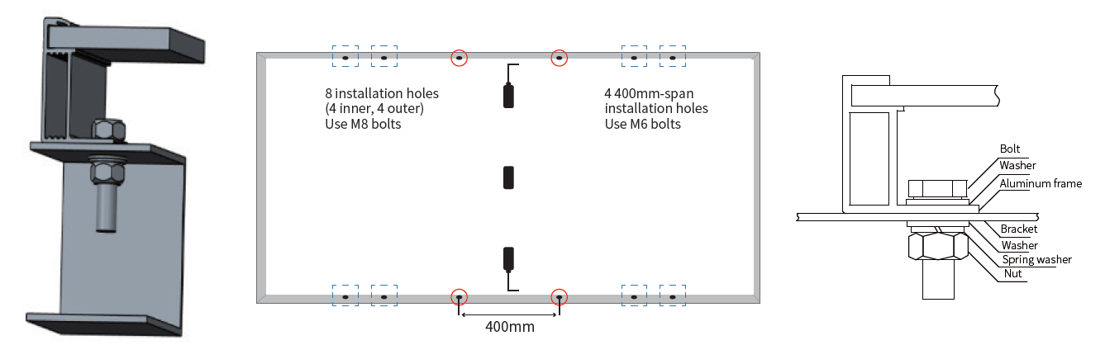
11.MECHANICAL MOUNTING METHODS
MOUNTING WITH BOLTS
Modules must be mounted on mounting holes located at rear side with the M6 stainless steel nut, bolt and washer. It is recommended to use stainless steel fixing only. Module mounting must use the pre-drilled mounting holes in the frame. Always select the length of mounting screw after considering a clearance of 5-10 mm between the Module back face & screw face to avoid any breakage of Module while tightening.
Applied torque should refer to mechanical design standard according to the bolt customer is using. For Mounting hole M6 bolt shall be use. Bolts shall be tightened to a torque of 16 -25 N
Note: -Do not drill additional mounting holes on the frame & glass surface of the Module. Doing so will void the warranty.

Slide 9
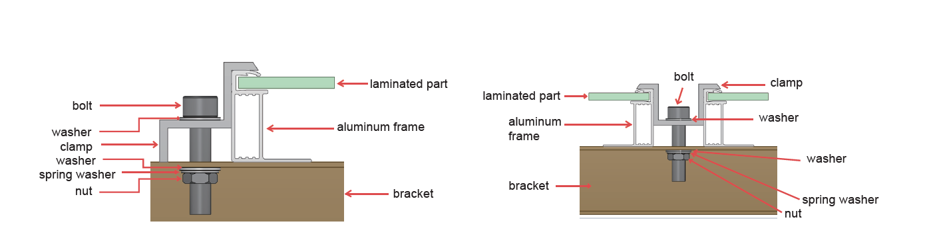
MOUNTING WITH CLAMPS
Each Module must be securely fixed to the mounting structure at a minimum of four points. The Module clamps shall not come into contact with the front glass and must not deform the frame. Be sure to avoid shadowing effects from the Module clamps. The clamp must overlap the module frame by at least 7mm (0.28in) but no more than 10mm (0.39in). The Module frame is not to be modified under any circumstances. When choosing this type of clamp-mounting method, use at least four clamps on each module, two clamps should be attached on each long sides of the module (for portrait orientation) or each short sides of the module (for landscape orientation). Depending on local wind and snow loads, additional clamps may be required to ensure that modules can bear the load. The applied torque shall be big enough to fix it steadily. For safety, it is better to follow the clamp manufacturer's recommendations.

Slide 10
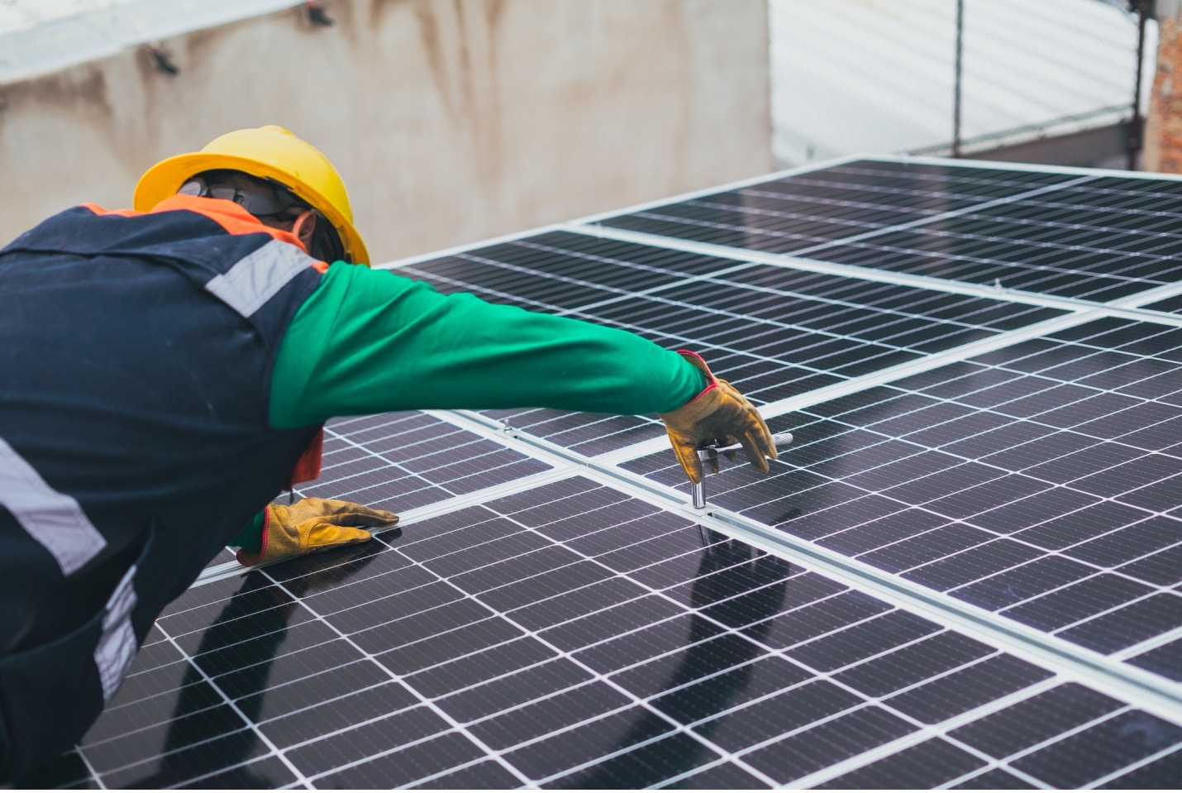
12. GROUNDING
The module is considered to be in compliance with this standard only when the module is mounted in the manner specified by the mounting instructions. A module with exposed conductive parts is considered to be in compliance with this standard only when it is electrically grounded in accordance with the manufacturer's instructions
Module frames should be connected to an earth ground for safety and protection from lightning. good connection between the grounding hardware is essential for an effective ground. The anodization on a Module frame provides a coating to minimize the corrosion due to weather and it acts as a barrier that reduces the effectiveness of the grounding connection. For an adequate ground, the grounding hardware should pierce the anodization layer.
Proper grounding is achieved by bonding the Module frame(s) and all metallic
structural members together continuously using a suitable grounding conductor. The grounding conductor or strap may be copper, copper alloy, or any other material acceptable for use as an electrical conductor. The devices have to be installed in accordance with the grounding device manufacturer's specified instructions. The grounding must be cross verified for its proper continuity.
Note: -
“Please avoid negative bias of the cells with respect to the grounded frames”. Solar modules can be installed with the use of third party listed grounding devices for grounding the metallic frames of PV modules. The devices have to be installed in accordance with the grounding device manufacturer's specified instructions

Slide 11
13. Warning and cautions
PV solar modules generate DC power under light conditions. The electricity generated by solar PV system can cause injury and/or death by electrical shock, fire or other dangerous impacts. Only those who have been trained professionally and are authorized shall install, repair or maintain solar PV modules.
To reduce the danger of electric shocks or the danger of fire, opaque materials can be flocked onto the solar PV modules during installation.
During installation, no electric terminal or component shall be touched, and only isolate tools shall be used whilst performing electrical connections.
Proper construction safety methods shall be applied at all times during installation to prevent falling solar PV modules from height causing death, injury or property damage.
Each solar PV module has a pair of male and female, waterproof connection terminals. When electrically connected in series, the connection terminal with the positive electrode of the first solar PV module should be connected to the next module’s negative electrode connection terminal.
Positive and negative electrodes of the solar PV module cannot be short-circuit connected, and cannot be disconnected when the module is under loading. Make sure there is no gap between the insulators of connection terminals This may cause injury and/or death by electrical shock, fire or other dangerous impacts.
Sunlight cannot be manmade. For rating and testing purposes standard simulation methods have been defined for solar PV modules. The peak power Pmax of the solar PV module is tested under standard testing circumstance (STC: 1000W/ m2; AM 1.5;temperature 25°C)
Under normal sunlight, currency or voltage generated by solar PV module may be much more than under STC. The rated voltage, rated currency in connectors, size of fuse and connected to the PV output controller should be calculated by the rated number of Isc and Voc multiplied by a coefficient 0.8. Please refer to each country’s laws and/or regulations applicable to solar installations to confirm locally differing coefficients.
14. Wiring of solar PV module
Each module has two 4mm2 diameter standard 90°C and sunlight resistant output cables, each terminated with plug & play connectors. This cable is suitable for applications where wiring is exposed to the direct sunlight. Wiring and electrical connections need to comply with the appropriate national electrical code.
For field connections, minimum 4mm2 diameter copper wires, insulated for a minimum of 90°Cand sunlight resistance shall be used. The outer diameter of wires should be 5mm-7mm.

Slide 12
15. Maintenance
Under most circumstances, normal rainfall is enough to keep the glass surface of the solar PV module clean. If too much dirt accumulates (i.e. sand, leaves, bird-droppings, etc.), soft cloth with soft detergent and water may be used to clean the panel's surface. Do not use cold water to clean the solar PV module during the day when the solar PV module's surface is heated up. Sudden and extreme change of temperature may damage the solar PV module.
When cleaning the back surface of the module, take care to avoid penetrating the substrate material.
Modules that are mounted flat (0° tilt angle) should be cleaned more often, as they will not' 'self-clean'' as effectively as modules mounted at a 15° tilt or greater. Maintenance should be carried out at least once a year solely by trained personnel.
Replacement modules must be of the same type. Do not touch live parts of cables and connectors. Use appropriate safety equipment (insulated tools, insulating gloves, etc.) when handling modules. Modules replacement should only be carried out by trained personnel.
When repairing a solar system, cover the front surface of modules with an opaque material. Solar PV modules generate high voltage when exposed to sunlight and can be dangerous.
If the measured voltage of the solar PV panel is only half of the rated value, the bypass diode might be faulty.
If - under normal irradiance conditions - the terminal voltage deviates more than +/- 5%than the rated value, the contacts and/or connections of panel might be faulty.
An electrical inspection, as well as a mechanical inspection of the solar PV system should be carried out every six months.
In case of any mis-performance, irregularity, or question, please ask a trained and authorized person.
Please note that maintenance instruction of all other systems parts need to be observed.

